Slide 1
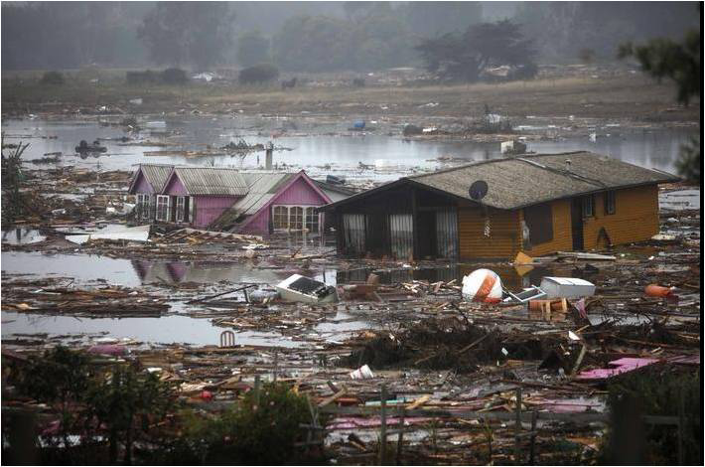
Tsunami Forecast Software
Nancy N. Soreide, D.W. Denbo, Y. Wei, D. Arcas, V.V. Titov
NOAA Center for Tsunami Research NOAA PMEL, Seattle, WA
Notes:
Introduction to tsunamis and forecasting with video (next slide)

Slide 2
Chile tsunami event (Feb 27, 2010) YouTube video embedded in slide … or play from YouTube or local video file
Notes:
** EMBEDDED YOUTUBE VIDEO – MUST HAVE INTERNET TO USE THIS **
Introduction to Tsunami events and forecasting
Notes:
http://www.youtube.com/noaapmel#p/u/0/nZ9Du7VfdSg
YouTube URL for embedded video is odd, i.e., http://www.youtube.com/watch?v=nZ9Du7VfdSg becomes http://www.youtube.com/v/nZ9Du7VfdSg

Slide 3
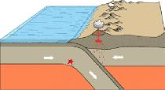
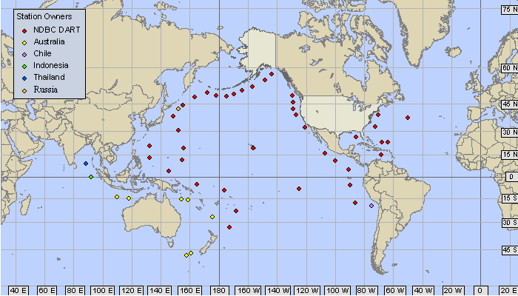
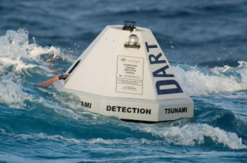
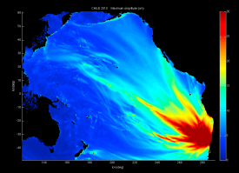
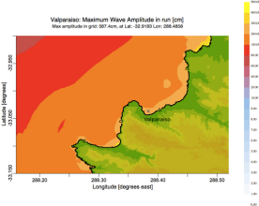
Overview of Tsunami Forecasting
Earthquake!
Data network
Model & data assimilation
Tsunami forecast guidance

Slide 4
5
4
3
2
The intensity of the earthquake alone does not predict the size of a tsunami … or even if a tsunami will occur.
1
Tsunami Intensity
0
-1
-2
-3
-4
5
6
7
8
9
10
Earthquake Magnitude
Courtesy V.K. Gusiakov
Notes:
The main and the most important feature of this graph is big scattering of the resulted tsunami intensity for earthquake with the same magnitude. Statistical nature of tsunami generation creates the most serious problem in operational tsunami warning.
Notes:
Dependence of tsunami intensity (on Soloviev-Imamura scale) on the magnitude Ms (on the left) and Mw (on the right) for the tsunamigenic earthquakes occurred in the Pacific from 1900 to 1999. The red line on the right figure shows the theoretical dependence I on Mw obtained in the paper Gusiakov, Chubarov (1987).

Slide 5
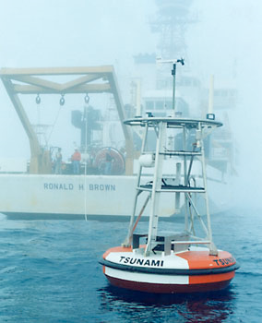
Tsunami detection buoys
DART® tsunami buoys measure the size of a tsunami, in the open ocean, before it comes ashore

Slide 6
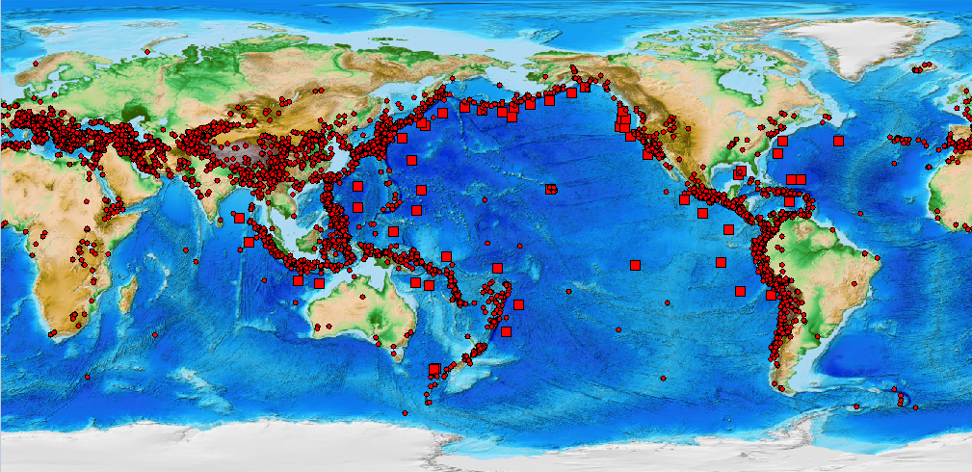
DART® Buoys are strategically located throughout the ocean
Real-time, high resolution buoy data is used to refine the forecast - while the tsunami is still propagating through the ocean.
DART®
Earthquake
Notes:
Locations of global significant earthquakes and DART buoys

Slide 7
NOAA Tsunami Forecast software
Combines
Earthquake seismic information
Real-time tsunami buoy measurements in the deep ocean
Computer models to predict tsunami propagation and coastal flooding
Provides
Real-time tsunami propagation forecasts
Real-time coastal flooding forecasts*
Installed at the NOAA Tsunami Warning Centers in Alaska and Hawaii
* For selected coastal communities

Slide 8
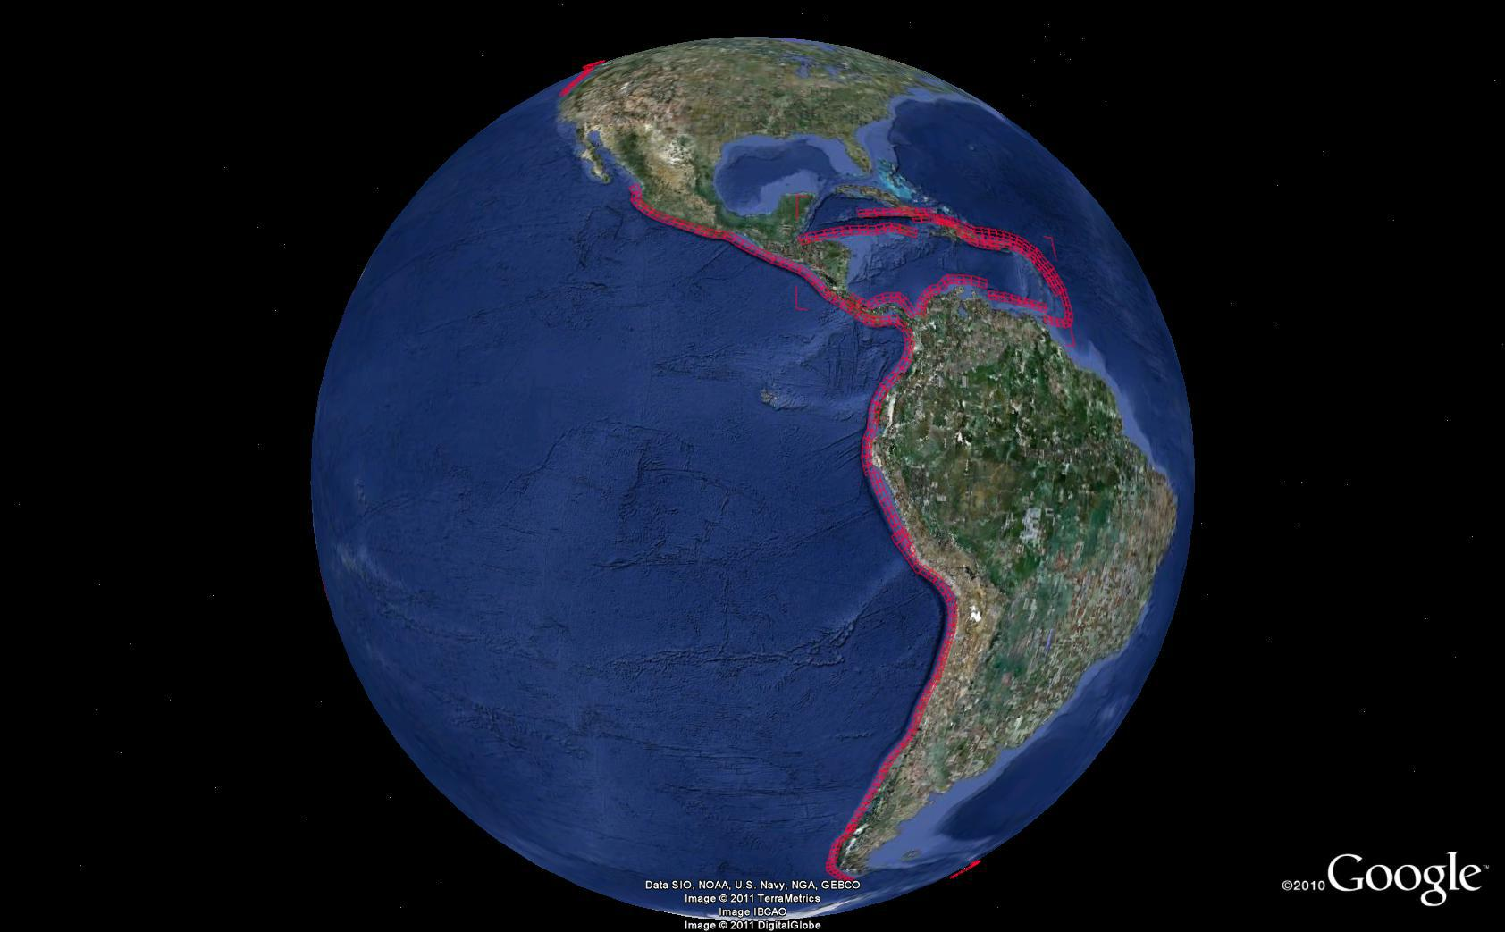
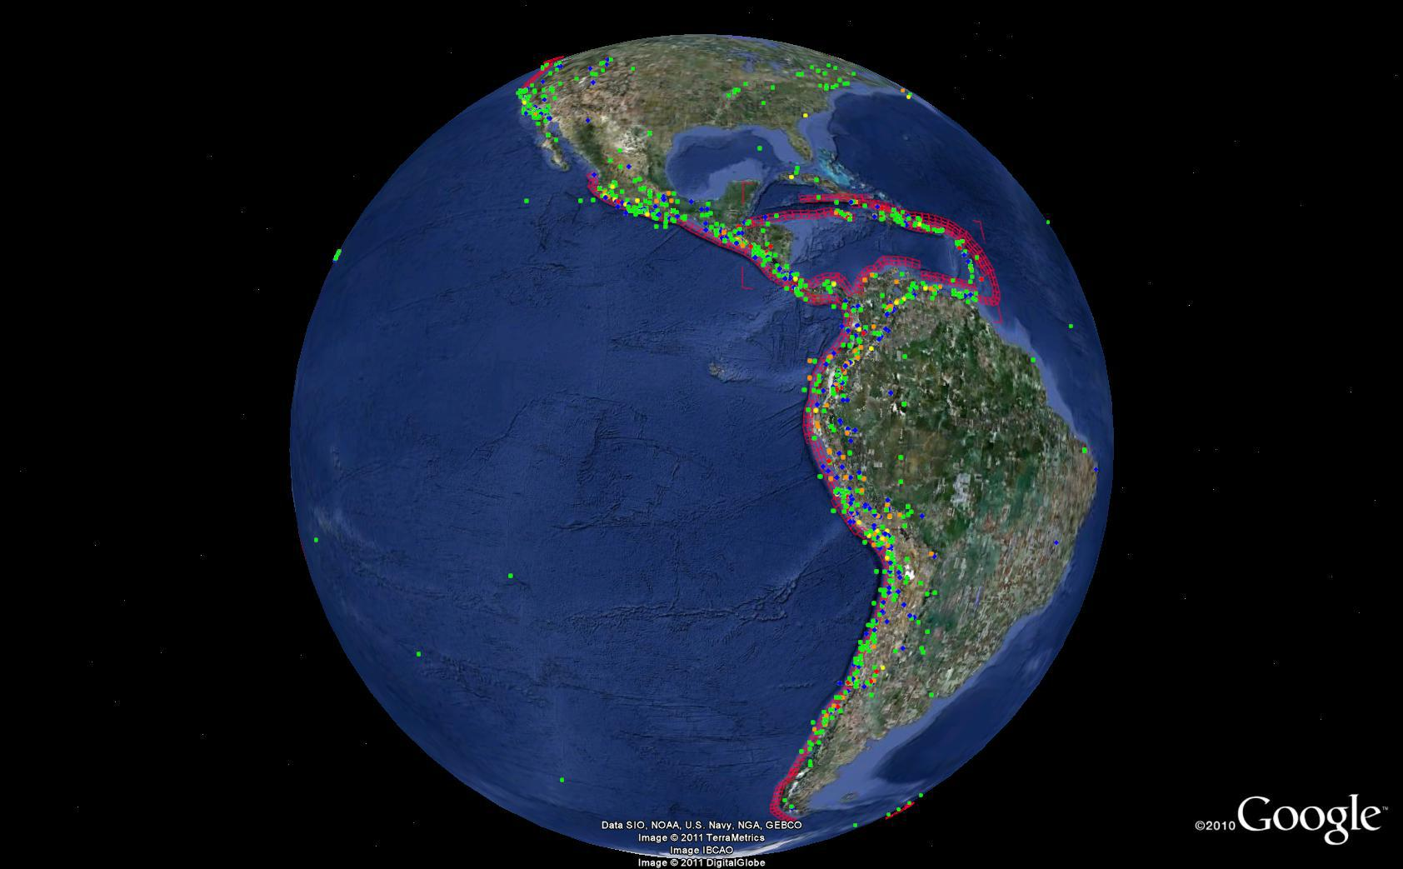
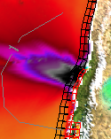
Tsunami propagation is pre-computed for Unit Sources along global coastlines
Unit earthquake source locations are co-located with earthquake locations
Notes:
When an earthquake occurs,
Unit Sources are combined to represent the location and magnitude of the earthquake,
And the corresponding pre-computed tsunami propagation runs are combined to provide an initial estimate of the actual tsunami propagation.
There are 1691 unit sources.

Slide 9
DART® data is assimilated into the model to refine the forecast
Maximum tsunami amplitude with travel time contours overlaid (Chile tsunami February 27, 2010)

Slide 10
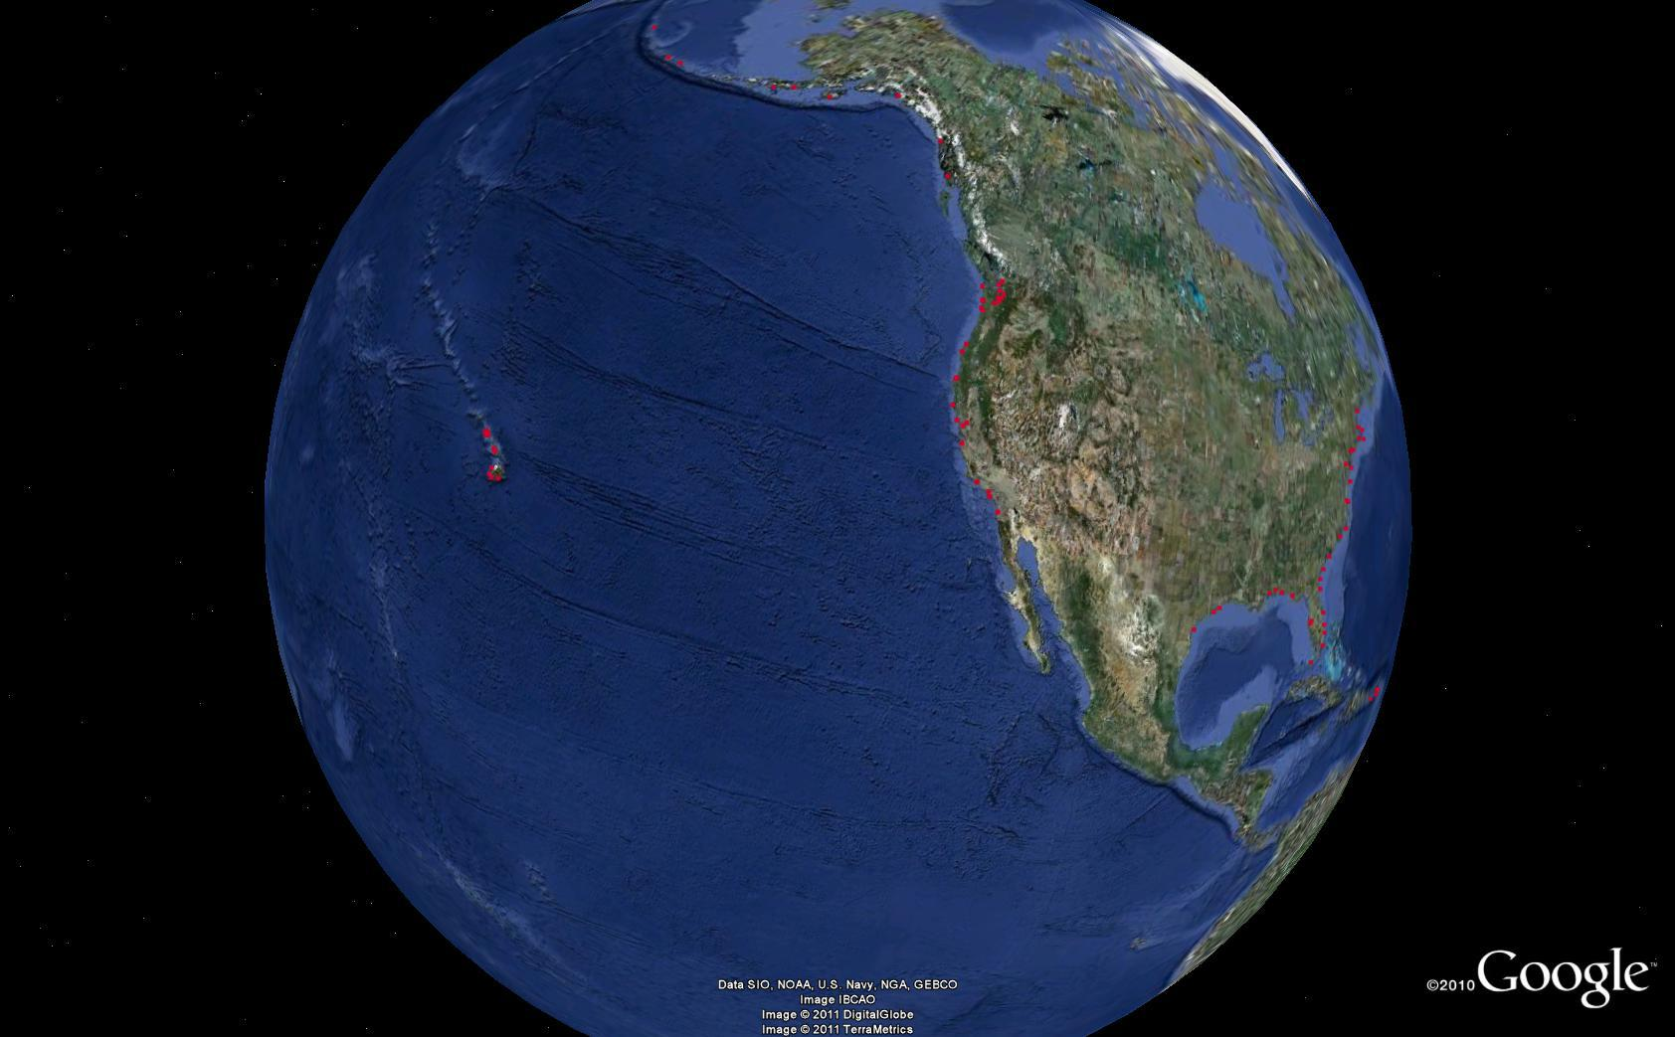
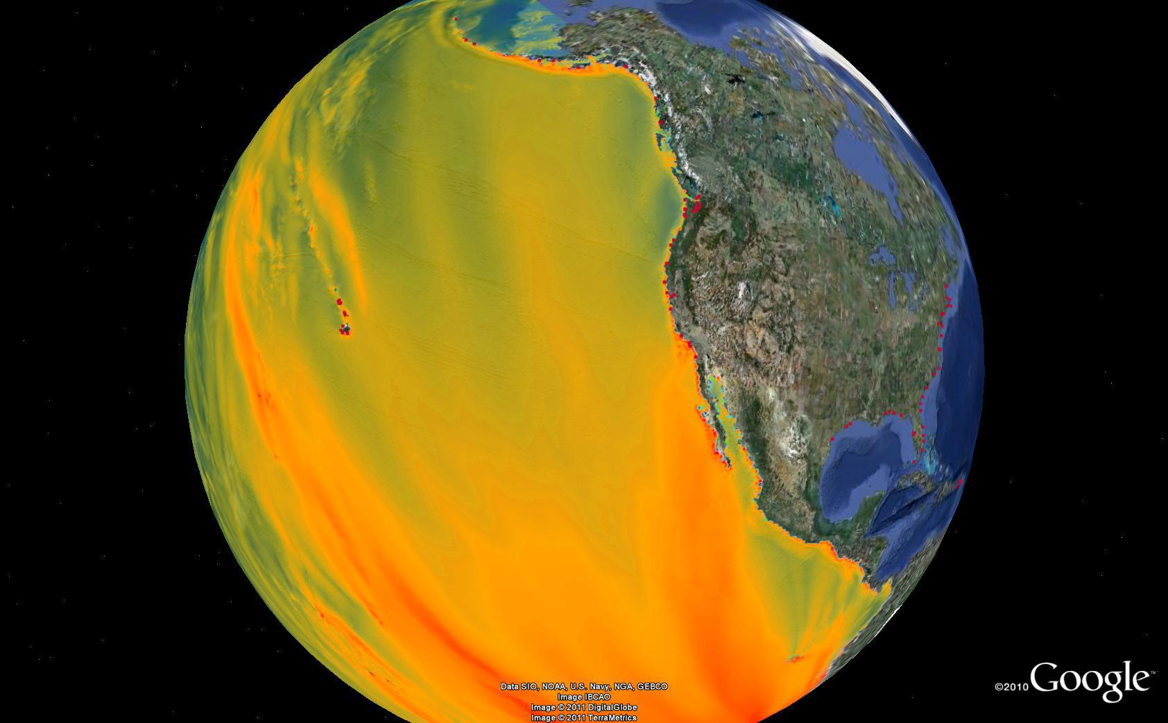
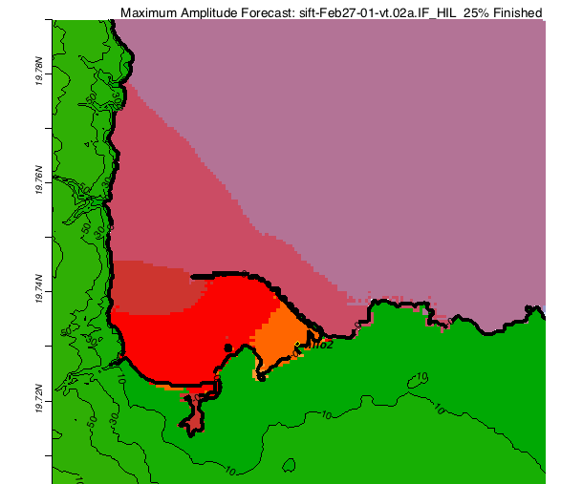
Real-time Coastal Flooding Forecasts for selected coastal communities
Local flooding model for Hilo, run in real time during event (Chile tsunami February 27, 2010)
Notes:
This is Hilo flooding forecast based on seismic source.
This is the forecast that we sent to TWCs first during the event.

Slide 11
Future forecast product Areas of flooding & Harbor currents
Flooding and Harbor Currents for Hilo, HI, computed in real time during the event (Chile tsunami February 27, 2010)
Notes:
Event page
http://nctr.pmel.noaa.gov/chile20100227/
Page_4_Hilo-vasily-email-20100227_0335am.png

Slide 12
http://nctr.pmel.noaa.gov
Maximum tsunami amplitude Chile tsunami February 27, 2010
NOAA Center for Tsunami Research
Located at NOAA PMEL in Seattle, WA

Slide 13
BACKUP SLIDES

Slide 14
Chile tsunami event (Feb 27, 2010) Video & Media Player embedded in slide … or play from YouTube or local video file
Notes:
** USE THIS AT AMS WHERE THERE IS NO INTERNET FOR SPEAKERS **
Introduction to Tsunami events and forecasting
This is an Embedded Media Player (windows media player) and Media (.wmv) – video file must be in same directory as presentation
http://www.youtube.com/noaapmel#p/u/0/nZ9Du7VfdSg/noaapmel

